Slide 1
PRESENTED BY:- AJIT MADAME PROJECT NAME :- HOUSE PRICE PREDICTION

Slide 2
AGENDAS
Problem Statement
Problem Understanding
EDA
Model Building
Selecting Best Model
Conclusion

Slide 3
PROBLEM STATEMENTS Houses are one of the necessary need of each and every person around the globe and therefore housing and real estate market is one of the markets which is one of the major contributors in the world’s economy. It is a very large market and there are various companies working in the domain. Data science comes as a very important tool to solve problems in the domain to help the companies increase their overall revenue, profits, improving their marketing strategies and focusing on changing trends in house sales and purchases. Predictive modelling, Market mix modelling, recommendation systems are some of the machine learning techniques used for achieving the business goals for housing companies. Our problem is related to one such housing company. A US-based housing company named Surprise Housing has decided to enter the Australian market. The company uses data analytics to purchase houses at a price below their actual values and flip them at a higher price. For the same purpose, the company has collected a data set from the sale of houses in Australia. The data is provided in the CSV file below. The company is looking at prospective properties to buy houses to enter the market. You are required to build a model using Machine Learning in order to predict the actual value of the prospective properties and decide whether to invest in them or not. For this company wants to know: • Which variables are important to predict the price of variable? • How do these variables describe the price of the house?

Slide 4
PROBLEM UNDERSTANDING Housing Attributes: Studying the structural, locational, and economic attributes of housing properties is crucial in understanding their mutually inclusive relationships with their pricing. House is one of human life's most essential needs, along with other fundamental needs such as food, water, and much more. Demand for houses grew rapidly over the years as people’s living standards improved. While there are people who make their house as an investment and property, yet most people around the world are buying a house as their shelter or as their livelihood. Predictive modelling, Market mix modelling, recommendation systems are some of the machine learning techniques used for achieving the business goals for housing companies.

Slide 5
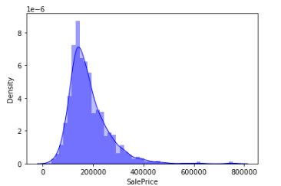
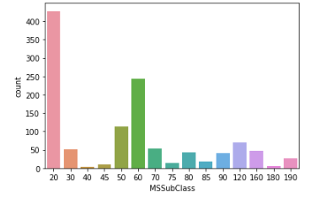
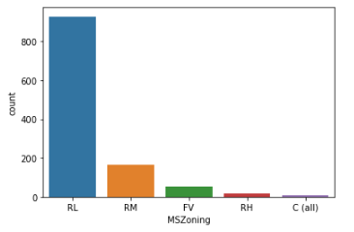
EXPLORATORY DATA ANALYSIS Observation: # Sale Price is not normally distributed. It contains some outliers. Sale Price are positively or right skewed. # It is dwelling involved while Selling the Houses. We can see, 1-STORY 1946 & NEWER ALL STYLES i.e. 20 has maximum count followed by 2-STORY 1946 & NEWER i.e. 60. 40 and 180 has very few counts than others. # We can see, residual with low density has maximum zone where houses are more number for selling followed by residual medium density. Very few houses are for sale in commercial zone.

Slide 6
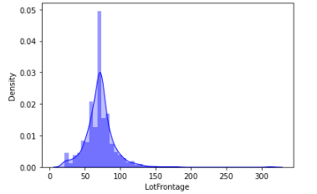
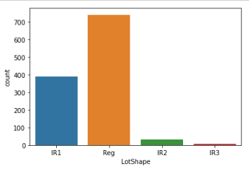
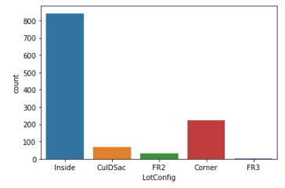
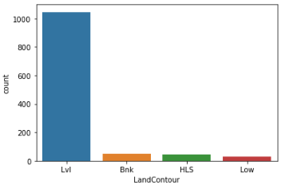
Observation: # LotFrontage means Linear feet of street connected to property. It is a right skewed column. It may have some outliers. We can see, Maximum LotFrontage are in 30 to 110. # Regular Shape of property contains maximum count followed by Slightly irregular. Irregular shape of property contains lowest count followed by Moderately Irregular. # Inside lot is the most common Lot configuration and it has maximum count than others. Frontage on 3 sides of property has lowest count. It means it rarely used configuration. # Most Properties have Near Flat/Level LandContour. Remaining contain almost same count of landcontour.

Slide 7
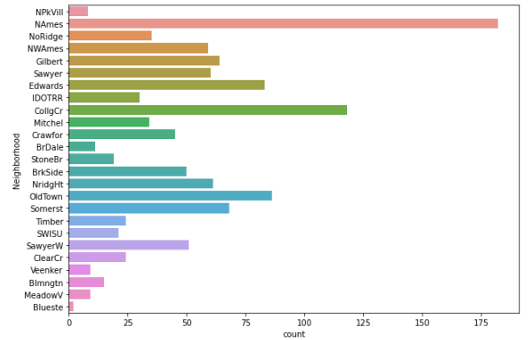
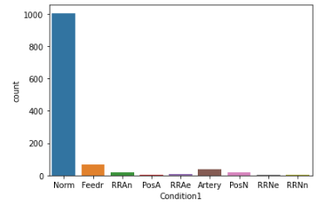
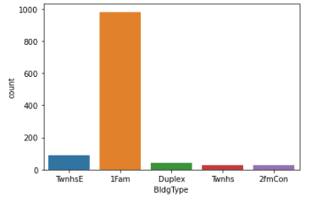
Observation: # Most Housing properties are situated in Neighborhoods of North Ames, followed by College Creek, Edwards and Old Town. Very Few houses in neighborhood of Bluestem. # Most Housing properties are in proximity to Normal conditions. Very few properties are in proximity to Within 200' of North-South Railroad. # Single-family Detached type of family dwelling are most common properties than others. Townhouse End Unit type of family dwelling are very few properties than others.

Slide 8
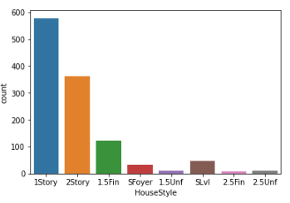
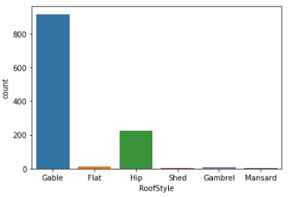
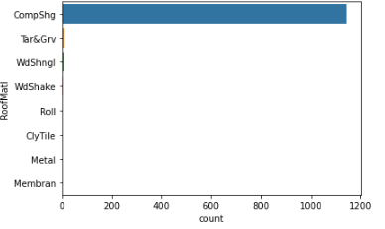
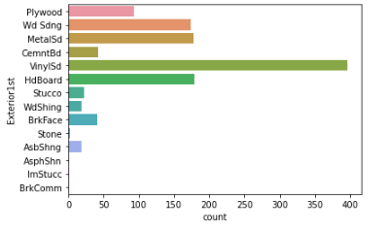
Observation: # Most Housing properties 1 storied and 2 storied. There are less housing properties wo and one-half story: 2nd level finished. # Most Houses have Gable roof style. Shed, Gambrel and Mansard has very low count. # Most Houses have roofs made of Standard (Composite) Shingle. Almost remaining all are having lowest count than CompShg. # Vinyl Siding is the most common exterior covering used followed by HD Board. Asphalt Shingles has lowest count of exterior are used.

Slide 9
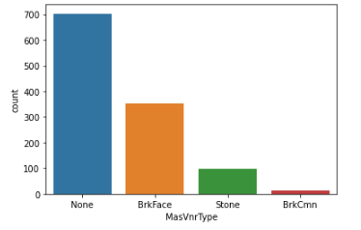
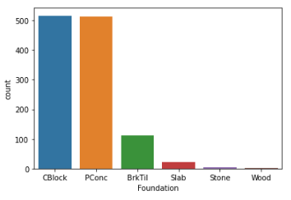
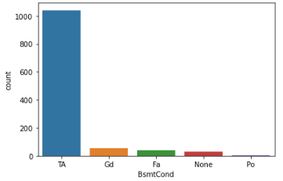
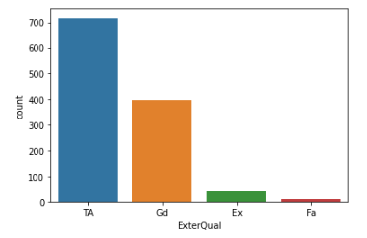
Observation: # Most Houses don't have a Masonry veneer type. while some have Brick Face Masonry veneer type. # The quality of the material on the exterior is most commonly average/typical. The quality of material on exterior is very few are fair. # Two of the most common foundation types are Cinder Block and Poured Contrete. Very few are used Wood type for foundation. # The general condition of the basement is commonly Typical with slight dampness. Some of Basement have very Poor condition.

Slide 10
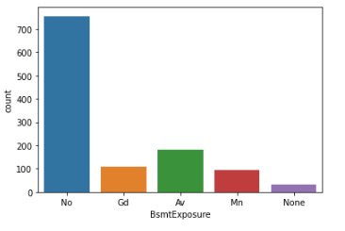
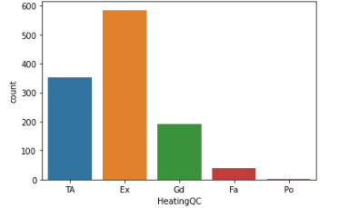
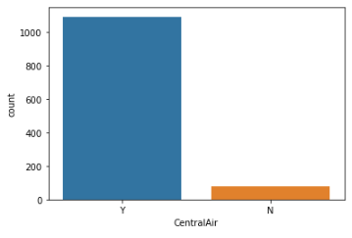
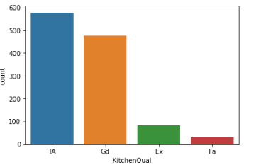
Observation: # Basements most commonly have no exposure. But Some Basement has Average Exposure. # Most houses have Excellent Heating quality and condition followed by Average/Typical. Very low almost don’t have poor quality of Heating condition of houses. # Most houses have Central air conditioning. Very few houses don’t have central air conditioning. # Most houses have Most houses have Typical/Average and Good Kitchen quality. Very few have fair quality of kitchen.

Slide 11
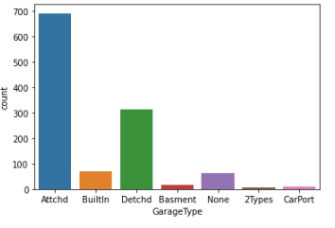
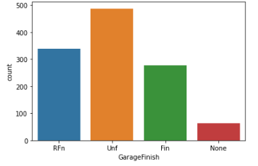
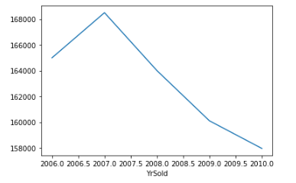
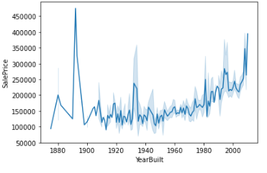
Observation: # Most houses have a Garage Attached to home. Many houses have a Detached from home. # Most houses have an Unfinished garage. But so many houses have a Rough Finished garage. # We can see, in 2007 housing sales price is in peak. But after 2007 Hoses price is drastically dropped. # We can see, houses price are increases after the year of built 1990. But in year of 1880 to 1990, sale price of house is high.

Slide 12
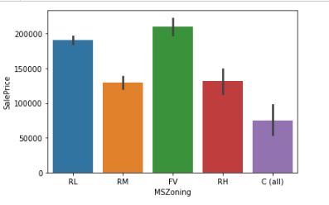
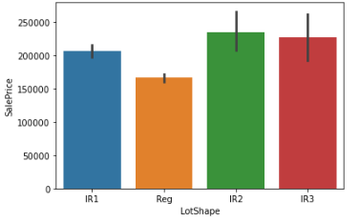
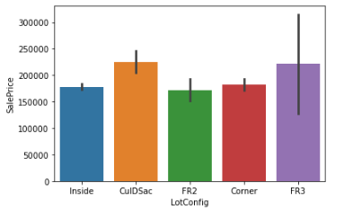
Observation: # Floating Village Residential has maximum sale Price of houses followed by Residential Low Density. Commercial houses are having low Sale Price comparatively. # Moderately Irregular type of shape houses has maximum sale price followed by Irregular. But Regular type of Lotshape has low sale price than others. # Cul-de-sac of Lot configuration has highest sale price than others followed by Frontage on 3 sides of property. Inside of Lot configuration has lowest sale price than others.

Slide 13
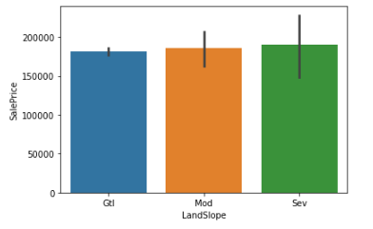
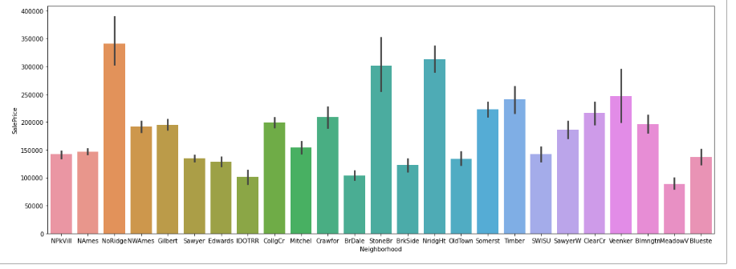
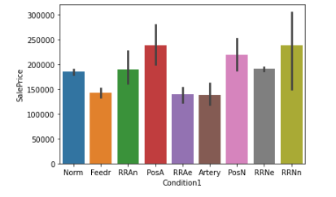
Observation: # Severe Slope has highest sale price than others. But all are having almost same sale price so slope is not affecting more to sale price. # Northridge has maximum sale price; it means that Northridge neighborhood has maximum sale price of houses followed by Northridge Heights. The houses are Meadow Village neighborhood has lowest sale price of houses than others. # The houses are proximity to condition Adjacent to positive off-site feature this has maximum sale price followed by Adjacent to North-South Railroad. Hoses have adjacent to arterial street has lowest sale price.

Slide 14
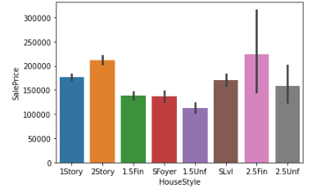
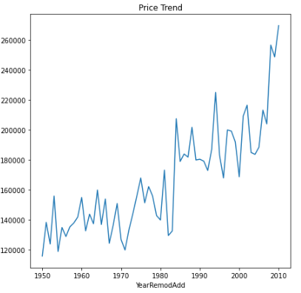
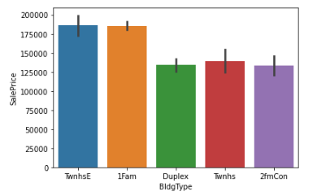
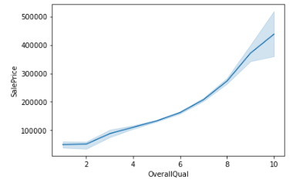
Observation: # Two and one-half story: 2nd level finished this type of houses dwelling has maximum sale price than others. One and one-half story: 2nd level finished it has lowest sale price. # Townhouse End Unit, this type of dwelling has maximum sale price than others followed by own house Inside Unit. Duplex has lowest sale than others. # We can see, Overall quality has linear relationship with Sale Price. If quality of houses is increasing then price of houses is also increasing. # It is observed that Sales value is higher for houses which were remodeled more recently.

Slide 15
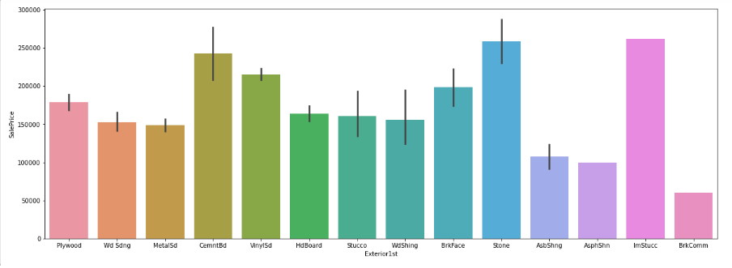
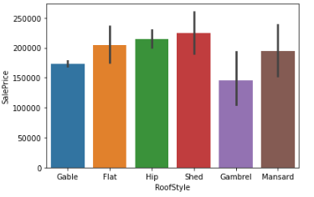
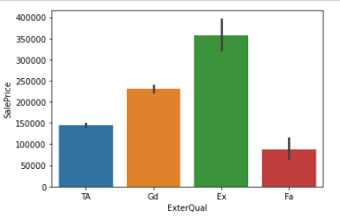
Observation: # Shed type of roof style of houses has maximum sale price than others followed by Hip type of roof style. Gambrel type of roof style of houses has lowest sale price. # Imitation Stucco type Exterior covering on house has maximum sale price followed by stone. Brick Common type Exterior covering on house has lowest sale price followed by Asphalt Shingles. # Excellent quality of exterior has maximum sale price followed by good quality. Fair quality houses have lowest sale price than others.

Slide 16
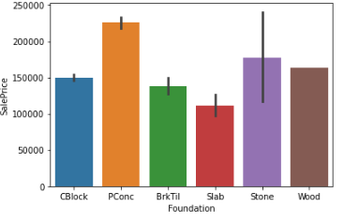
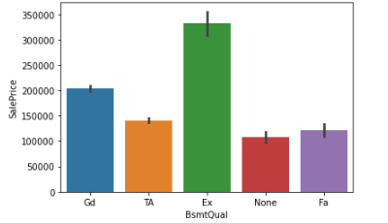
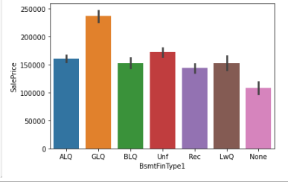
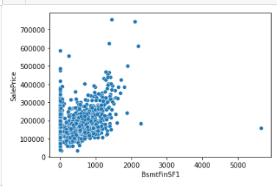
Observation: # Poured Contrete type of foundation houses has maximum sale price than others followed by Stone. Slab type of foundation has lowest sale price than others. # Excellent quality of Basement has more sale price than others followed by good quality of Basement. None of type or no Basement houses has lowest sale price than others. # Good Living Quarters type of Rating of basement finished area has highest sale price than others followed Unfinished. No Basement has lowest sale price. # It has linear relationship with each other’s. Maximum sale price of Type 1 finished square feet is lies in 0 to 2000.

Slide 17
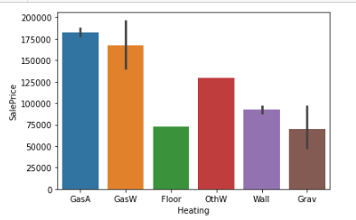
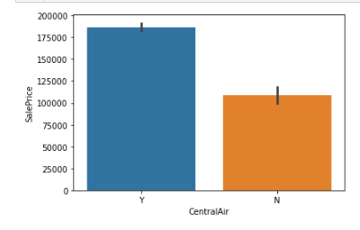
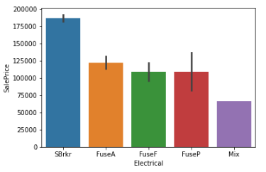
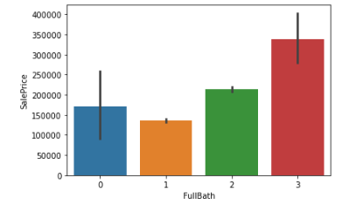
Observation: # Gas forced warm air furnace of heating houses has more sale price than others followed by Gas hot water or steam heat. Floor Furnace used heating has less sale price than others. # Those houses have central Air conditioning that house has maximum sale price than others. Those houses are not used central air conditioning has minimum sale price than others. # Standard Circuit Breakers & Romex type electrical system has higher sale price than others. Mix type of electrical system has lower sale price than others. # Type 3 of FullBath has maximum sale price than others. Type 1 FullBath has lowest sale price than others.

Slide 18
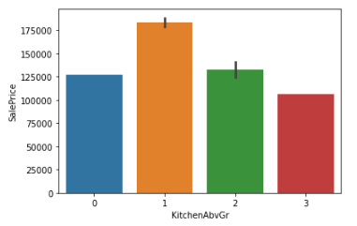
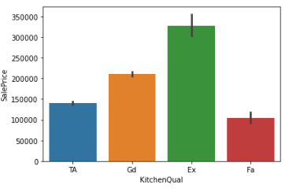
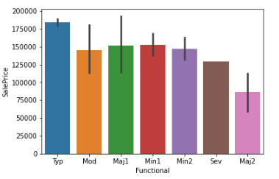

Observation: # 1 type of kitchen above grade has maximum sale price followed by 2. All Kitchen has equally distributed up to 100000. # Excellent type quality of Kitchen has maximum sale price followed by good quality of Kitchen. Fair quality of Kitchen has lowest sale price than others. # Typical Functionality of garage near to house has maximum sale price than others. Major Deductions 2 has lowest sale price. # Contract 15% Down payment regular terms sale type has more sale price than others. Others type of sale type has lower sale price.

Slide 19



Observation: # Partial type of sale condition has maximum house sale price than others. Adjoining Land Purchase of sale condition house of sale price. # New Homes are the most popular in all types of zoning. Partial sale type of condition has highest sale price. # Low interest contract are the most popular sale types in low density. New Houses are top among other sale type and it has good sale price.

Slide 20


Observation: # Partially irregular and irregular plot shapes are most popular in low and medium residential zones. # Most housing properties established in levelled regions in North Ridge sell for the highest. Most Housing properties in levelled regions of Stone Brook sell for highest followed by banked region and hillsides. Houses in levelled region of NorthRidge heights sell for the most while housing properties in depressed regions of Veenker sell for the highest prices.

Slide 21


Observation: # Most housing properties that are newly established in Crawford,Stone Brook, Timberlane,North Ridge Heights,Bloomington Heights sell for the highest. Most Housing properties in North Ridge sell for trade, foreclosure, short sale and normal sale in North Ridge. # Most houses sold in North Ridge,North Ridge Heights, Somerset,TimberLane,Veenker, Bloomington Heights are in low density residential zones. North Ames has more houses sold in High density residential zones, while Crawford has more houses sold in medium density residential zones.

Slide 22


Observation: # Warranty Deed - Conventional, Home just constructed and sold, Contract Low InterestCourt Officer Deed/Estate are the most common sale types. # Excellent quality of Gas forced warm air furnace and Gas hot water heating systems fetches the highest amount of money.

Slide 23

Encoding the Categorical Columns Before Proceeding with finding the correlations of the columns, the data of the categorical columns needs to be encoded using Label Encoder.

Slide 24

Visualizing correlation of feature columns with label column. OverallQual,GrLiveArea,GarageCars,GarageArea,TotalBsmtSF,1stFlrSF,FullBath,TotRmsAbvGrd,MasVnrArea,FirePlaces have the strongest positive correlation with SalePrice. WhileBsmtQual,ExterQual,KitchenQual,GarageFinish,House_age,Remod_age,HeatingQC,Garage_age have the strongest negative correlation with SalePrice.

Slide 25


FEATURE SELECTION Features were first checked for presence of multicollinearity and based on the respective ANOVA f-score values, the feature columns were selected that would best predict the Target variable, to train and test machine learning models.

Slide 26


Select Kbest Method Using SelectKBest and f_classif for measuring the respective ANOVA f-score values of the columns, the best 70 features were selected. Using StandardScaler, the features were scaled by resizing the distribution values so that mean of the observed values in each feature column is 0 and standard deviation is 1. From sklearn.model_selection import train_test_split, It is used to split the data into train and test data. Training data comprised 70% of total data whereas test data comprised 30% based on the best random state that would result in best model accuracy.

Slide 27


MODEL BUILDING Finding Best Random State Linear Regression

Slide 28



Cross Validation of model

Slide 29

Random Forest Regression:

Slide 30


Cross Validation of model

Slide 31



Gradient Boosting Regressor: Cross validation of model

Slide 32



KNeighbors Regressor: Cross Validation of model

Slide 33



XGBOOST Regressor: Cross Validation of model

Slide 34


Regularization: Mean Squared Error and Root Mean Squared Error metrics were used to evaluate the Model performance. The advantage of MSE and RMSE being that it is easier to compute the gradient. As, we take square of the error, the effect of larger errors become more pronounced than smaller error, hence the model can now focus more on the larger errors. Cross validation is a technique for assessing how the statistical analysis generalizes to an independent data set. It is a technique for evaluating machine learning models by training several models on subsets of the available input data and evaluating them on the complementary subset of the data. Using cross-validation, there are high chances that we can detect over-fitting with ease.

Slide 35


Selecting Best Model Based on comparing Accuracy Score results with Cross Validation results, it is determined that Random Forest Regressor is the best model. It also has the lowest Root Mean Squared Error score. Hyperparameter Tuning

Slide 36

Based on the input parameter values and after fitting the train datasets The Random Forest Regressor model was further tuned based on the parameter values yielded from GridsearchCV. The Random Forest Regressor model displayed an accuracy of 89.26% The Model Test on Testing Data

Slide 37
Key Finding And Conclusions # Structural attributes of the house Structural attributes of the house like lot size, lot shape, quality and condition of the house, garage capacity, rooms, Lot frontage, number of bedrooms, bathrooms, overall finishing of the house etc. play a big role in influencing the house price. # Neighborhood qualities can be included in deciding house price. # Training dataset is small because of this Data loss is huge so I am not removing outliers.

Slide 38
Limitation of this works and future scope # The housing market is affected by economic status, interest rate, real income and population density change. In contract to these market – side considerations, the available inventory can decide house price. For cycle of rising demand and limited supply, house prices will go up and threat of insecurity will increase. # In short economic factors may affect the houses price but, in this dataset, no economic features are used.

Slide 39


